Slide 1
Module 4- System Access and file System
There are two ways to access windows operating system.
One is accessing through the console which we have been accessing through the console which is virtual box console.
The second way which is the most common way is the remote desktop client.
How To: Use Remote Desktop Client
1} Remote Desktop server set-up. The first step is that you must first configure the computer you wish to control.
2} Start the Client. From a Windows computer click on the Start Menu and search for “Remote Desktop Connection” to find the application. ...
3} Enter Address Into Computer Field. ...
4} Show Options. ...
5} Connect.

Slide 2
File System and Description
OS store data on disk drive using a structure called filesystem consisting of files, directories, and the information need to access and locate them.
In computing, a file system or filesystem (often abbreviated to fs) controls how data is stored and retrieved. Without a file system, data placed in a storage medium would be one large body of data with no way to tell where one piece of data stops and the next begins

Slide 3

File system=closet
This Photo by Unknown Author is licensed under CC BY-ND

Slide 4
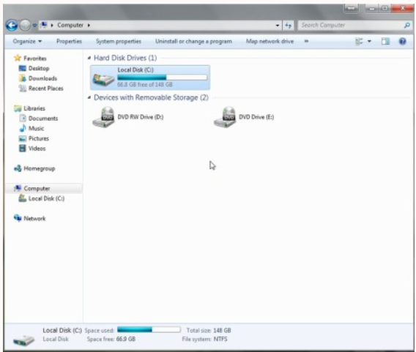
Understanding the Windows File System
Computer systems generally save their information on a hard drive. The way that data is organized is called a file system. Let's talk a little bit about the way Windows organizes its data, and how to access it.
Storage devices
Within Microsoft Windows operating systems, storage devices are denoted with a letter followed by a colon (:). The hard drive, the main storage medium, is often represented with the letter C:. In fact, virtually every Windows based computer will label the hard drive C:. Secondary hard drives, optical drives (like your DVD drive), and flash drives will receive the drive letters D:, E:, F: and so on.

Slide 5
Different types of files system
Windows File Systems
The Microsoft Windows operating systems have always supported various versions of the FAT file system. FAT stands for File Allocation Table, a term that describes what it does: maintains a table of each file's space allocation.
In addition to FAT, all Windows operating systems since Windows NT support a newer file system called NTFS—New Technology File System. For Windows NT, the NT stood for new technology.
All modern versions of Windows also support exFAT, which is designed for flash drives.
ReFS (Resilient File System) is a newer file system for Windows 10 and Windows 8 that includes features not available with NTFS, but it's currently limited in several ways. You can see which versions of Windows support each version of ReFS in this table.

Slide 6
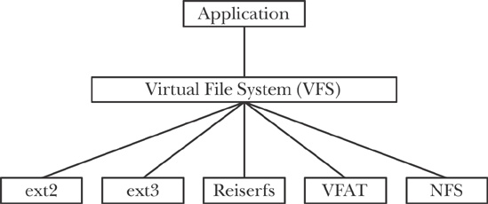
Linux files system

Slide 7
Mac files system
Disk Utility on Mac supports several file system formats: Apple File System (APFS): The file system used by macOS 10.13 or later. Mac OS Extended: The file system used by macOS 10.12 or earlier. MS-DOS (FAT) and ExFAT: File systems that are compatible with Windows.

Slide 8
NAVIGATING TO FILE SYSTEM
What is file system navigation?
There are many ways to navigate to files and folders in windows
GUI
Command line: dir, cd
Search bar

Slide 9
File type and creation
Everything in an OS is a file.
Plain text files
Folder/Directory
Image, audio or video
System peripheral files
Files links
Scripts or executable
There are many different way to create a file or directory. (practice all different way)
GUI
Command line
application

Slide 10
File Properties
Each file has its properties associated with it.
Name
Icon
Type of file
Location
Size
Date creation
Permissions
Additional details

Slide 11
Finding files and directories
Finding files and directories is very useful feature in any OS.
GUI
Command line “ dir /s filename.*”
File maintenance
File maintenance includes copy, delete, move and rename a file.
We will cover both ways to perform file maintenance.
GUI
Command line
Copy, del, move, rename

Slide 12
File Operation
File operation is writing, opening, editing and saving a file.
In windows you can open s file through command line but it will be open in GUI application associated with it.
Command line “filename”
Most of the operation is done trough the GUI

Slide 13
File Editing Short-Cut Key
Ctrl + P = print the text file
Ctrl + A = select all the contents of text file
Ctrl + Z = cancel the previous action done by the user
Ctrl + X = cut the selected text
Ctrl + C = copy the selected text
Ctrl + V = paste the text which is lastly stored in the buffer
Ctrl + F = find the word in the text file
Ctrl + H = find and replace the text
Alt or f10 = highlight the menu bar and use the keyboard to select
F5 = insert the system time and date
F3 = find the next word, if it is used and find option

